Slide 1
WLAN-BT-Coexsitence
- VotaryTech

Slide 2
This page compares 11a vs 11b vs 11g vs 11n to provide difference between 11a,11b,11g and 11n, 802.11 standards.
802.11a
Modulation Scheme OFDM
Data Rate 6,9,12,18,24,36,48,54 Mbps
RF Carrier 5GHz
Bandwidth 20MHz
802.11b
Modulation scheme DSSS/CCK
Data rate 1,2,5.5 and 11 Mbps
RF Carrier 2.4Ghz
802.11g
Modulation Scheme DSSS/CCK and OFDM both
Data Rate support of both 11b and 11a
RF Carrier 2.4GHz
Bandwidth 20 MHz
802.11n
Modulation Scheme OFDM and DSSS/CCK
It supports legacy fallbacks of 11a/11b/11g systems
Bandwidth 20MHz and 40MHz
Data rate -As per 11a/11b/11g.
-It supports upto about 72Mbps for 20MHz bandwidth with multiple antennas
-It supports upto about 150Mbps for 40MHz bandwidth with multiple antennas

Slide 3
Bluetooth technical specifications
Following are the technical features of bluetooth technology.
RF Frequency | 2.4GHz,READ MORE
Transmit power | 100 mW(Max.) 1mW(Min.),READ MORE
Data rate | About 1Mbps
Distance | 100 meter(max.), 1 meter(min.)
RF Bandwidth | 220 KHz to about 1MHz
Modulation type | Gaussian FSK (GFSK)
Number of RF carriers | 79(max.), 23(min.)
Topology | upto 7 links in a star configuration
hopping rate | 1600 hops per second
Access type | FH-TDD-TDMA

Slide 4
BT and WLAN Operating Conditions
WLAN Operating Conditions
2.4G/5G
WLAN Scan
Connection Setup/DHCP
WLAN Idle
WLAN Active
SoftAP
P2P Client/GO
BT Operating Conditions
Inquiry
Page
Scan
Connection Setup
ACL Links
SCO/eSCO Link
ACL(A2DP Link)
SNIFF Mode

Slide 5
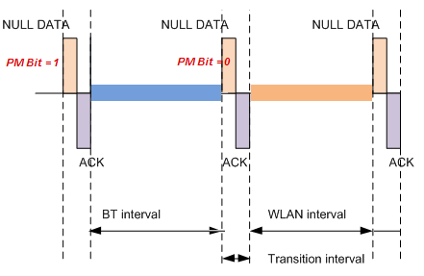
WLAN-BT-Control Mechanism
Mechanisms
Below mechanisms are used to stay away from the WLAN RF channel or protect or reserve its transmission intervals
Null Frame with PM Bit ON/OFF
When CXM moves RF from WLAN to BT, it inform AP as entering to power save mode, so AP will not send any downlink to STA.
This mechanism is implemented by sending NULL frame PM bit 0 and PM bit 1.

Slide 6
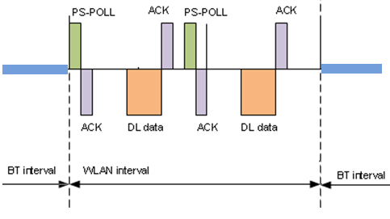
PM Bit ON / PS POLL / PM Bit OFF
  In this option after PM bit with 1 is sent. Instead of sending PM bit 0, the WLAN can use PS-POLL
Cts2Self
  This mechanism is used to block out other WLAN stations in the neighborhood for specific time periods thereby allowing/giving timing control to the station.
  This mechanism hurts other stations as effectively blocks the WLAN media.

Slide 7
WLAN-BT_RF Sharing Technique
choose an appropriate policy. Each policy has different way of sharing the Antenna between WLAN/BT
  (A2DP) – Provide a fixed primary interval, If BT has more data then it is given an extension
  (SCO) – Use PSPOLLS to get WLAN data and all SCO packets are prioritized over WLAN
  INQUIRY/OPP) – Provide fixed interval to BT/WLAN

Slide 8
- To be Continued
Thank You

